Slide 1
ST77903_A2170 QSPI Client Application Considerations
Darren_Chuang
2020/11/20

Slide 2
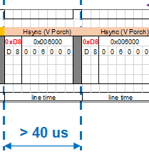
Notes for QSPI application_ Single Lane Command
Frame 1
> 500ns && < 100ms
> 40us
> 40us
> 40us
Frame 2
> 1ms && < 100ms (WDT)

Slide 3
Integration of Customer Application Notes
The Minimum Linetime of Vsync , Hsync(Porch) and Hsync(Data) should not be less than 40us, generally more than 47us .
Delay between Line and Line cannot be less than 500ns and cannot be greater than IC WDT Setting .
The Delay between Frame and Frame cannot be less than 1ms and cannot be greater than the WDT of the IC Setting .
using Single Lane Command to transmit, except for Hsync(Data) , all others use 0xD8/0xDE .
using Quad Lane Command to transmit, if the Data Format is 5-6-5 , each Line must have two Clock Dummy CMDs after Hsync is sent before Data can be sent .

Slide 4
Thank you
Sitronix Confidential The information contained herein is the exclusive property of Sitronix and shall not to be distributed, reproduced, or disclosed in whole or in part without prior written permission of Sitronix.
© 2013 Sitronix Technology Corporation. All rights reserved.

